Slide 1


Literature Review
Reservoir Computing to Next Gen Reservoir Computing PART 1
Aayush Jannumahanti
Graduate Student Researcher

Slide 2
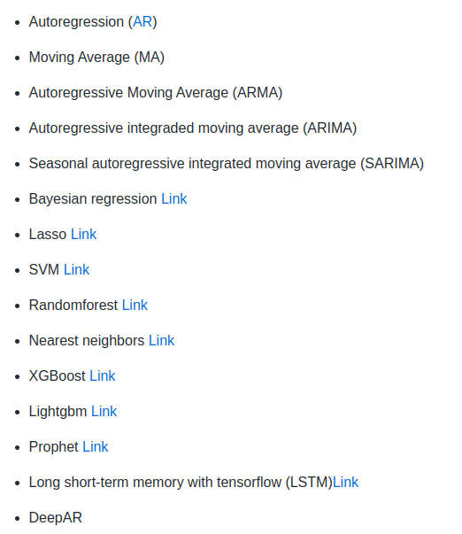
Introduction
‹#›
There are several types of time series forecasting models available, several of these models give efficient results
UMBC VLSI-SOC GROUP
Notes:
https://github.com/imhithanks/time-series-forecasting-with-python link to above model

Slide 3
Introduction Con..
‹#›
But Reservoir Computing is better!
With 1) More Data 2) Better compute power
Reservoir computing is a novel technique that researchers adapt to receive efficient results
Reservoir is better than RNNs, LSTMs and GRUs
Why? as Reservoir learn with less data than LSTM (with equal number of trainable parameters)
Some developments in BP for RNNs perform better on problems which require long memory, but it’s hard for BP RNN training, unless networks are specifically designed to deal with them. Long short-memory (LSTM) and gated recurrent unit (GRU) are advanced designs to mitigate shortcomings of RNN. But when the length of input sequence exceeds a certain limit, the gradient will still disappear. Meanwhile, each LSTM cell have four full connection layers, if the time span of LSTM is large and the network is very deep, the calculation will be very heavy and time-consuming. Further, too many parameters will lead to over fitting risk.
UMBC VLSI-SOC GROUP
Notes:
https://hal.inria.fr/hal-03780006/file/Hinaut2022_Euroscipy_Poster_Reservoirpy_v1-HAL.pdf ReservoirPy poster
BP Back Progpagation

Slide 4
Motivation
‹#›
What is a Reservoir?
“Reservoir” means network can store past inputs: also called “liquid state machines” (Maass et al 2002) and “echo state networks” (Jaeger & Haas 2004)
Reservoir is rich enough to do all different types of computation on temporal data, data that change in time
ESNs are recurrent randomized neural networks in which the state dynamics are implemented by an untrained recurrent hidden layer, whose activation is used to feed a static output module that is the only trained part of the network
Nonlinear dynamical systems abound in the sciences and in engineering. If one wishes to simulate, predict, filter, classify, or control such a system, one needs an executable system model.
UMBC VLSI-SOC GROUP
Notes:
http://www.columbia.edu/cu/biology/courses/w4070/Reading_List_Yuste/haas_04.pdf ESN Paper
https://arxiv.org/pdf/2012.02974.pdf design and applications of ESN

Slide 5
Background (Existing Work)
‹#›
However, it is often infeasible to obtain analytical models. In such cases, one has to resort to black-box models, which ignore the internal physical mechanisms and instead reproduce only the outwardly observable input output behavior of the target system.
If the target system is linear, efficient methods for black-box modeling are available. Most technical systems, however, become nonlinear if operated at higher operational points (that is, closer to saturation). Although this might lead to cheaper and more energy-efficient designs, it is not done because the resulting nonlinearities cannot be harnessed.
Many biomechanical systems use their full dynamic range (up to saturation) and thereby become lightweight, energy efficient, and thoroughly nonlinear. Here, we present an approach to learning black-box models of nonlinear systems, echo state networks (ESNs). An ESN is an artificial recurrent neural network (RNN). RNNs are characterized by feedback (“recurrent”) loops in their synaptic connection pathways.
UMBC VLSI-SOC GROUP

Slide 6
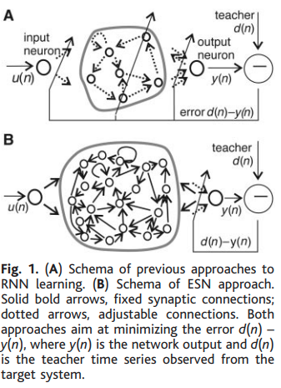
Background (Existing Work Con..)
‹#›
This approach..
UMBC VLSI-SOC GROUP

Slide 7
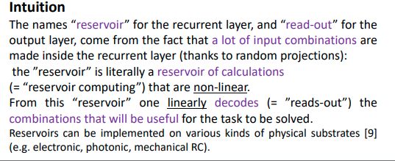
Background (Existing Work Con..)
‹#›
This approach..
UMBC VLSI-SOC GROUP
Notes:
https://hal.inria.fr/hal-03780006/file/Hinaut2022_Euroscipy_Poster_Reservoirpy_v1-HAL.pdf ReservoirPy poster

Slide 8
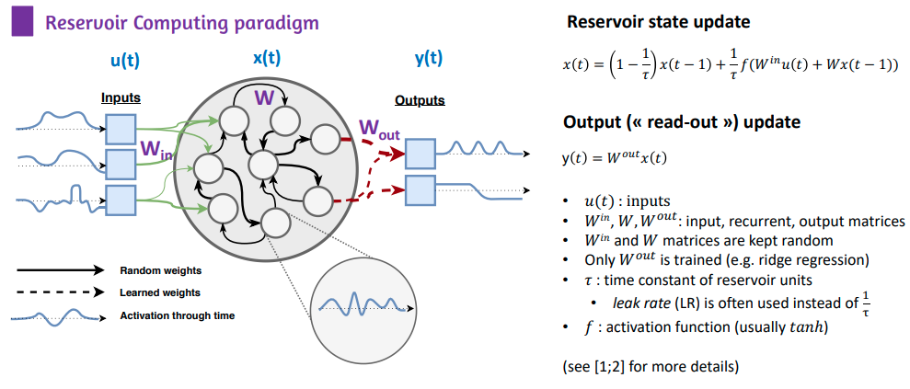
Background (Existing Work Con..)
‹#›
This approach..
UMBC VLSI-SOC GROUP
Notes:
Different activation functions and its types https://abhigoku10.medium.com/activation-functions-and-its-types-in-artifical-neural-network-14511f3080a8
Difference between Linear and Non Linear activation functions https://bit.ly/3X8phsr

Slide 9
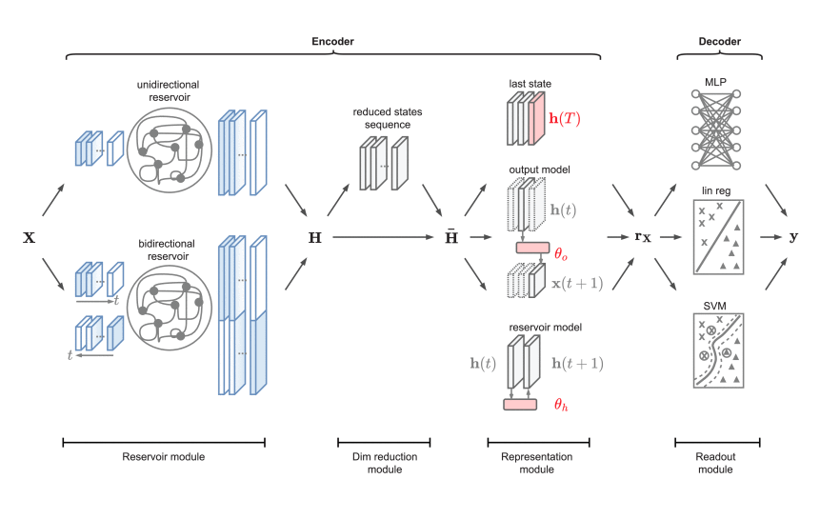
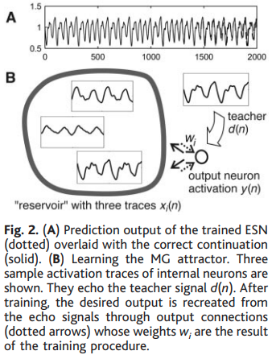
Proposed Work
‹#›
UMBC VLSI-SOC GROUP
Notes:
ReservoirPy Architecture

Slide 10
Results and Discussion
‹#›
This approach..
Intro to NextGENRC https://github.com/quantinfo/ng-rc-paper-code
https://github.com/FilippoMB/Time-series-classification-and-clustering-with-Reservoir-Computing
https://pyrcn.readthedocs.io/en/latest/?badge=latest PyRCN Docs
PyRCN has successfully been used for several tasks:
Music Information Retrieval (MIR), Multipitch tracking, f0 Onset detection analysis of spoken language, GCI detection in raw audio signals
Time Series Prediction - Mackey-Glass benchmark test, Stock price prediction
Ongoing research tasks: Beat tracking in music signals, Pattern recognition in sensor data, Phoneme recognition, Unsupervised pre-training of RCNs and optimization of ESNs
UMBC VLSI-SOC GROUP

Slide 11
Experimental/Simulation Setup
‹#›
Ran a PYRCN script on MNIST Classification data set for detecting MNIST digits
Link to Repo https://bit.ly/40xsKUa
UMBC VLSI-SOC GROUP
Notes:
https://mybinder.org/ run https://github.com/TUD-STKS/PyRCN then see examples

Slide 12
Thank you
‹#›
Questions?
UMBC VLSI-SOC GROUP

